Slide 1


SIMATS ENGINEERING
SAVEETHA INSTITUTE OF MEDICAL AND TECHNICAL SCIENCES
Capstone Presentation : Batch
CSA1640-Data Warehousing and Data Mining for Clusters
TITLE: AI Integrated Student Analytics and Early Warning System for Academic Risk Prediction
BY:
Attar Mohammad Shahid(192311321)
Bijja Sai Madhava (192372346)
Besta Chaitanya Raj (192372351)
GUIDED BY:
Dr.CHITHRA & Dr. ARUNA
Professor/CSE
SSE, SIMATS

Slide 2
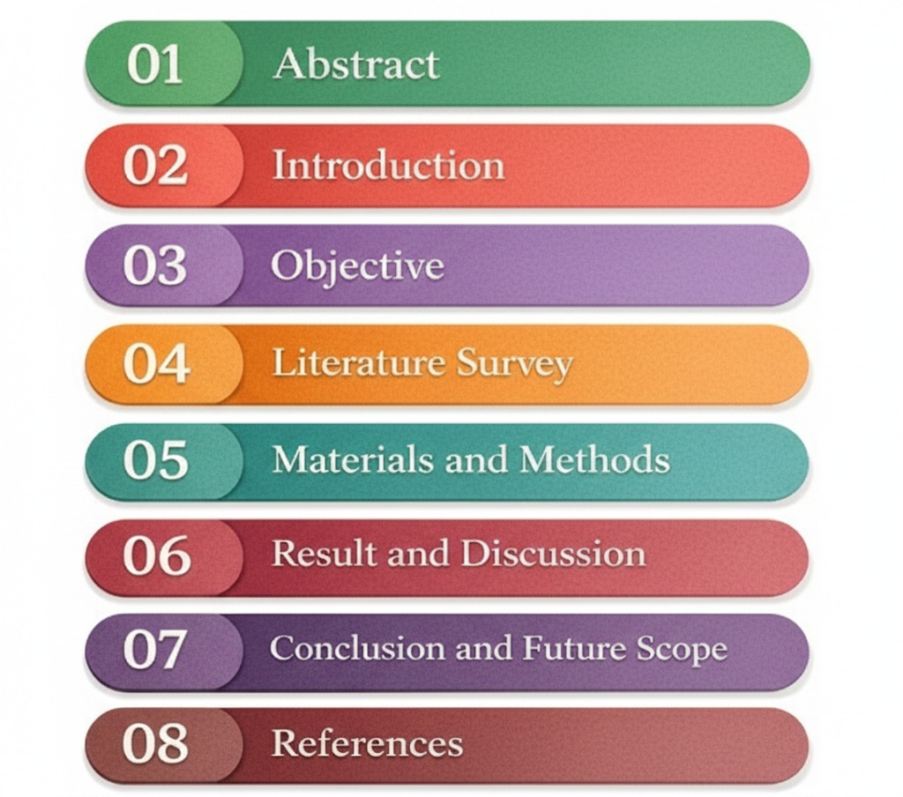
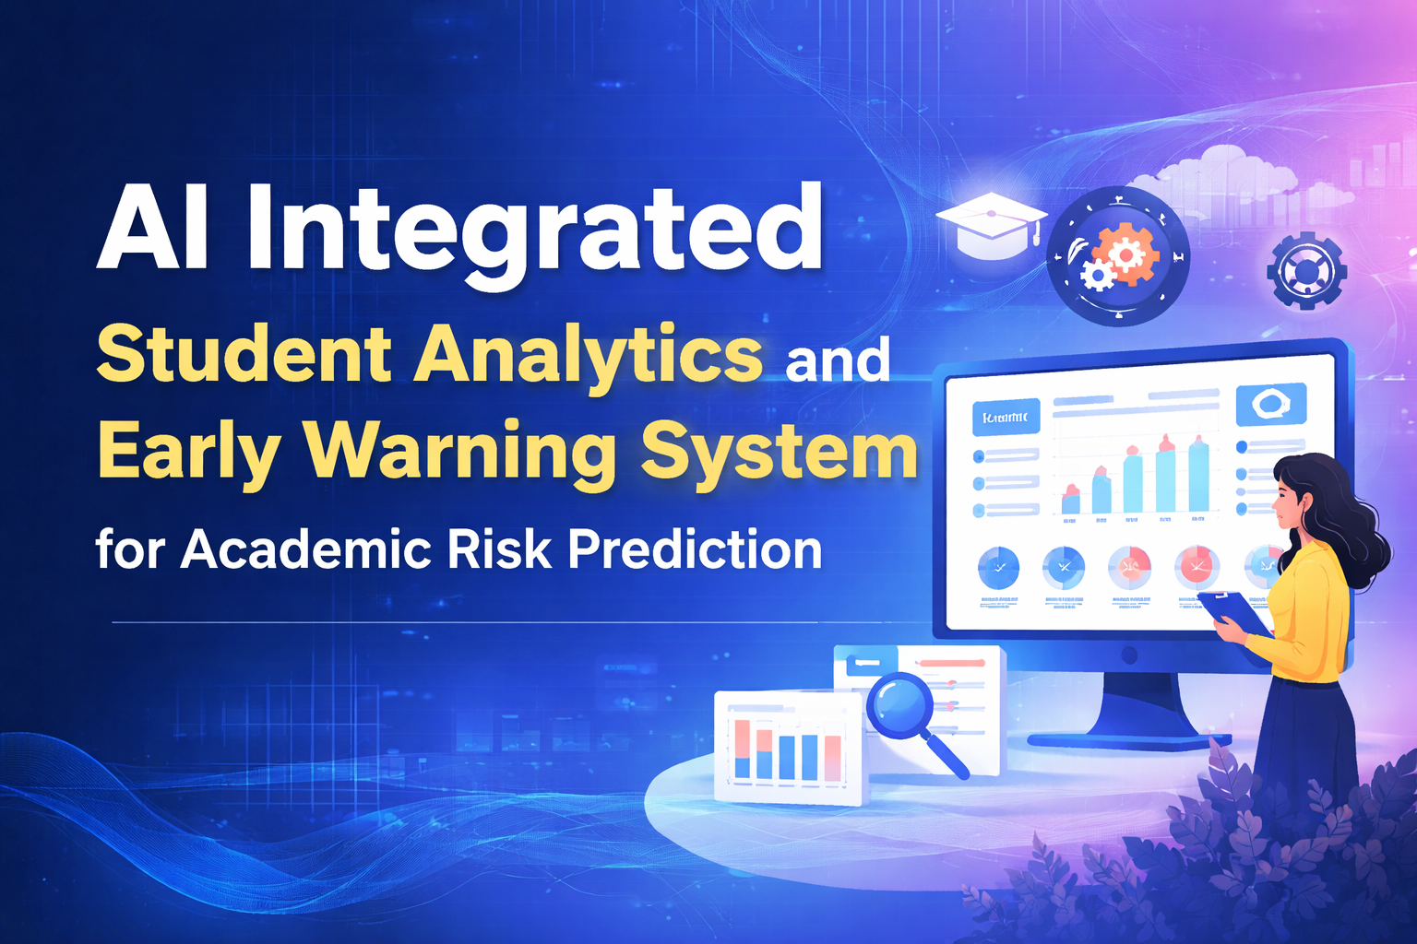
TITLE: AI Integrated Student Analytics and Early Warning System for Academic Risk Prediction

Slide 3
01
Abstract
This project presents an integrated student analytics and early warning system designed to support academic decision-making in universities.
The system analyzes attendance, academic performance, disciplinary records, and extracurricular activities using data-driven techniques.
Predictive models are applied to estimate daily absence and course pass or fail probabilities.
Risk stratification and automated alerts enable early identification of students requiring academic or behavioral intervention.
The proposed system enhances institutional efficiency by enabling proactive, data-informed student support.
The system integrates visualization, predictive analytics, and alert mechanisms within a unified web-based platform.

Slide 4
02
Introduction
Universities generate large amounts of student data, but it is often underutilized for meaningful academic decision-making.
Traditional methods of monitoring attendance and performance are manual, time-consuming, and lack early warning capabilities.
There is a need for an integrated system that combines attendance, grades, discipline, and activity data in one platform.
Predictive analytics can help identify students at academic risk before serious problems occur.
This project aims to provide a data-driven, automated, and interactive solution to improve student monitoring and academic support.

Slide 5

03
Objective
To design and develop an integrated web-based system for monitoring student attendance, academic performance, disciplinary records, and extracurricular activities.
To analyze historical student data and identify patterns related to attendance behavior and academic performance.
To predict daily student absence and course pass/fail outcomes using data-driven predictive models.
To implement a risk stratification mechanism that categorizes students into low, medium, and high academic risk levels.
To generate early warning alerts and interactive reports that help faculty and administrators take timely corrective actions.

Slide 6
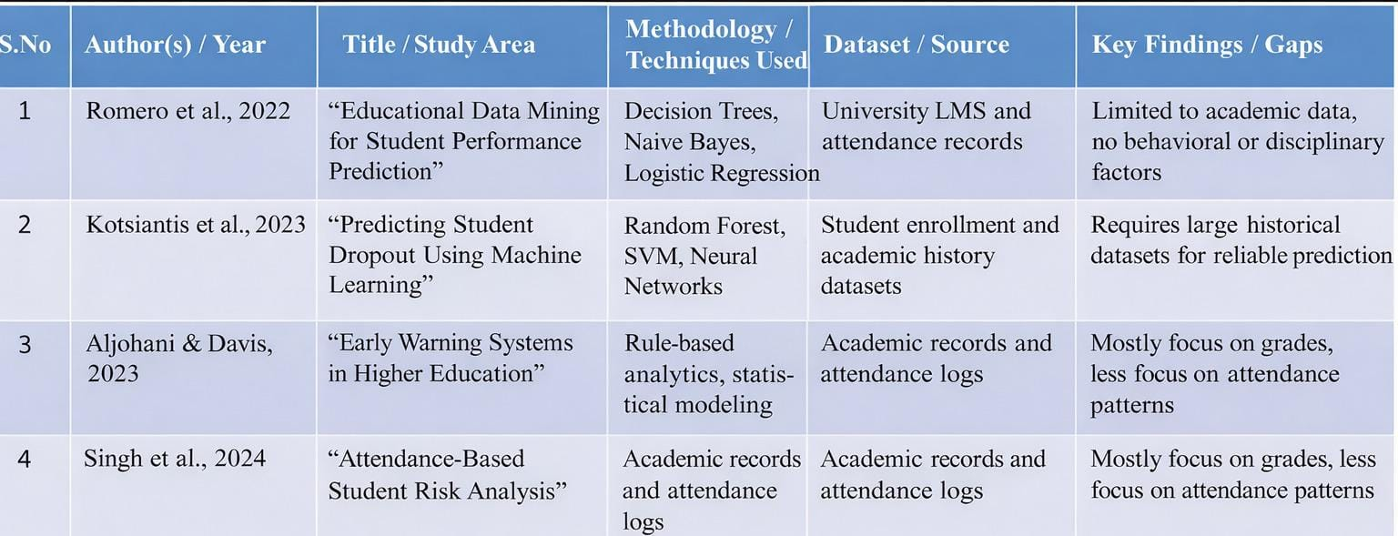
04
Literature Survey

Slide 7
05
Materials and Methods
Data Sources: Attendance, grades, disciplinary records, extracurricular activities, and student profiles.
Data Preprocessing: Data cleaning, normalization, encoding, and integration.
Techniques Used: Clustering, association rules, prediction models, and risk stratification.
Prediction & Alerts: Daily absence prediction, pass/fail prediction, and early warning alerts.
Tools & Platforms: Spring Boot, Thymeleaf, Tailwind CSS, MySQL, Java ML, Chart.js, CSV/PDF reports.

Slide 8
1.Data cleaning and Preprocessing
Module-1
Centralized student data is consolidated from attendance, academics, discipline, and extracurricular sources.
Missing values, duplicates, and inconsistent records are cleaned from the dataset.
Categorical attributes are normalized for uniform representation.
Historical and current data are prepared for time-based trend analysis.
Key derived metrics such as attendance percentage and risk scores are computed.
Data is transformed into an analysis-ready format for multidimensional queries.
Preprocessing improves data accuracy and ensures reliable analytics and predictions.

Slide 9
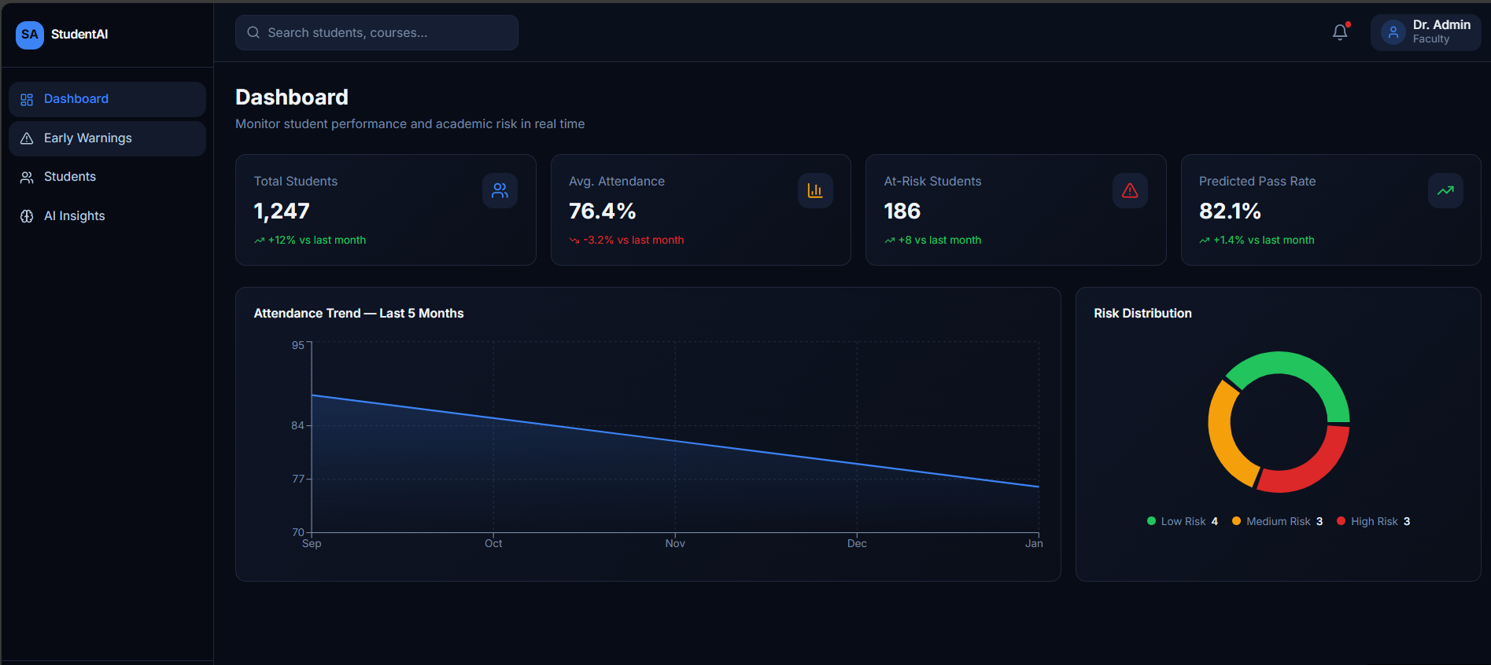
Module-1
System Architecture Diagram:

Slide 10
Module-2
2. Student-wise Analysis
Individual student profiles are analyzed using attendance, academic, and behavioral data.
Student-wise attendance patterns are evaluated across days, courses, and time slots.
Academic performance trends are analyzed using internal, mid, and assignment scores.
Behavioral indicators such as disciplinary records are incorporated into student analysis.
Extra-curricular participation is examined to understand its impact on academics.
Risk levels are assigned to each student based on combined performance indicators.
Student-wise insights support personalized monitoring and early intervention.
High-risk students are flagged for early intervention and counseling support.The analysis supports personalized academic guidance and performance improvement strategies.

Slide 11
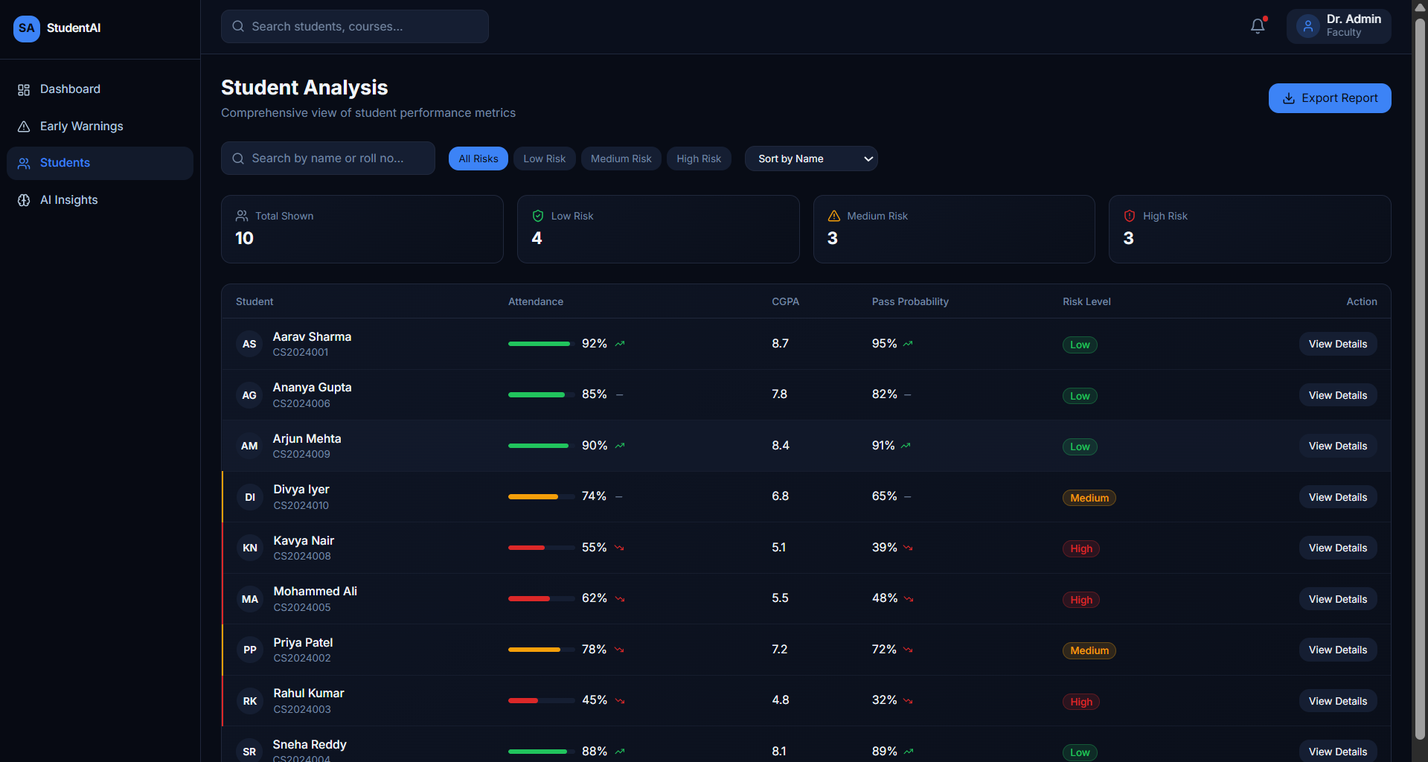
Module-2
System Architecture Diagram:

Slide 12
Module-3
3. Course-wise Analysis
Purpose: To provide personalized academic support and recommendations to students based on their attendance, performance, and behavior patterns.
Data Inputs:
Student profile data (program, semester, department, category).
Attendance history and absence patterns.
Academic performance data (internal, mid, assignments).
Types of Recommendation Approaches:
Rule-Based Recommendation: Suggests actions based on predefined academic and attendance rules (e.g., low attendance → counseling recommendation).
Pattern-Based Recommendation: Uses historical trends of similar students to suggest corrective actions and support strategies.
Outputs:
Personalized academic recommendations (attendance improvement plans, study support).
Targeted intervention suggestions (counseling, mentoring, additional assessments).

Slide 13
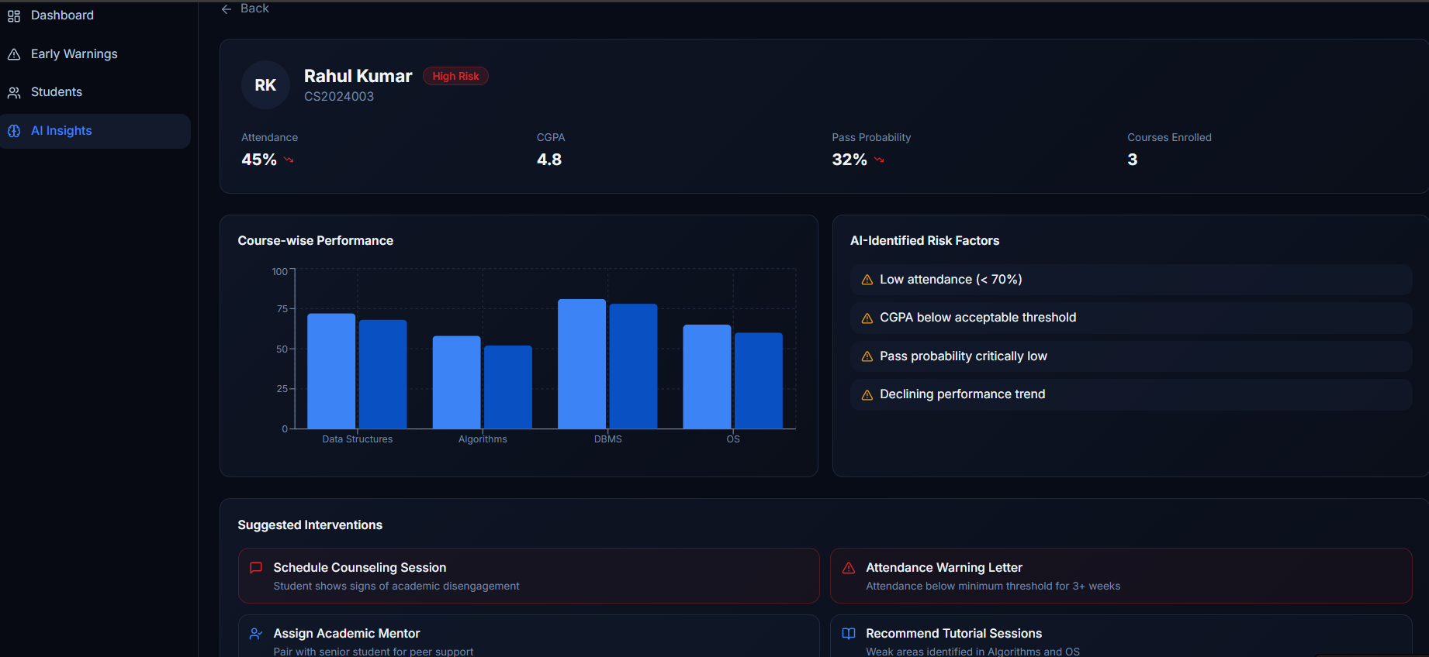
Module-3
System architecture Diagram:

Slide 14
06
Result and Discussion
Results:
Early warning alerts helped in identifying at-risk students before serious academic decline.
Absence and pass/fail prediction models improved accuracy in forecasting student performance.
Interactive dashboards enhanced monitoring of attendance, grades, and risk levels for administrators.
Discussion:
Student analytics enables institutions to understand learning behavior and attendance patterns more effectively.
Personalized risk profiling supports targeted academic counseling and intervention.
Predictive models assist faculty and administrators in planning timely support strategies to improve student success.

Slide 15
07
Conclusion and Future Enhancement
Conclusion:
The student analytics and early warning system provides intelligent insights for monitoring academic performance and attendance behavior.
The system enhances institutional effectiveness by offering personalized risk assessment and timely intervention support.
Predictive models improve academic planning, student retention, and overall educational quality.
Future Enhancements:
Incorporate real-time analytics using live attendance systems and IoT-based classroom monitoring.
Extend the system to support mobile applications for students and faculty for instant alerts and updates.
Integrate AI-driven counseling assistants for personalized academic guidance and mentoring.

Slide 16
08
References
Romero et al. (2022) – Explained how educational data mining techniques like classification and clustering can be used to analyze student attendance, behavior, and academic performance for better decision-making.
Kotsiantis et al. (2023) – Showed that machine learning models such as Random Forest and SVM can accurately predict student success and identify students at academic risk.
Jayaprakash et al. (2023) – Proposed an early warning system that uses academic and attendance data to generate alerts for students who may fail or drop out.
Hussain et al. (2024) – Demonstrated that predictive analytics can effectively estimate pass/fail outcomes and help institutions intervene early.
Aljohani & Davis (2024) – Highlighted the importance of integrated learning analytics platforms for monitoring student progress and improving retention rates.

Slide 17
Thank You

